Slide 1
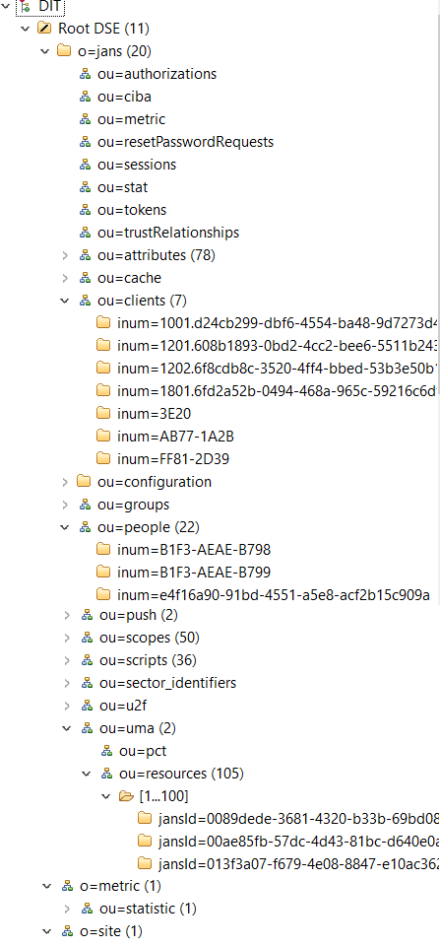
Convert object classes to tables
Table name = lower(objectClass)
doc_id | e4f16a90-91bd-4551-a5e8-acf2b15c909a | Last RDN value | VARCHAR(48) Primary key, Not null, Unique
objectClass | jansPerson | Last objectClass | VARCHAR(48)
dn | inum=e4f16a90-91bd-4551-a5e8-acf2b15c909a,ou=people,o=jans | LDAP DN | VARCHAR(128)
attr1 (from OC) | attr1 value | Attribute value
attr2 (from OC) | attr2 value
…
Convert attributes based on these rules
Schema type | SQL Type
1.3.6.1.4.1.1466.115.121.1.7 | Boolean syntax | TINYINT
1.3.6.1.4.1.1466.115.121.1.12 | Distinguished name syntax | VARCHAR(128) Add property to schema to allow override size. Max allowed size is 255
1.3.6.1.4.1.1466.115.121.1.15 | Directory string syntax | VARCHAR(128) / BLOB Add property to schema to allow override size. If size bigger than 256 use BLOB
1.3.6.1.4.1.1466.115.121.1.24 | Generalized Time syntax | DATETIME
1.3.6.1.4.1.1466.115.121.1.27 | Integer syntax | INT
Each type above with multivalued=true | json | Store values in SQL types specified above as JSON array

